Slide 1

Cheap Book Club

Slide 2
Presented By
Penniless Students
Dakota Reel Co-Founder
Alex Williams Co-Founder
Chantel Humpherys Co-Founder
Berenice Saenz Co-Founder
CIS 1020-Section 068
Spring 2010

Slide 3
For
President Bioteau
Salt Lake Community College

Slide 4
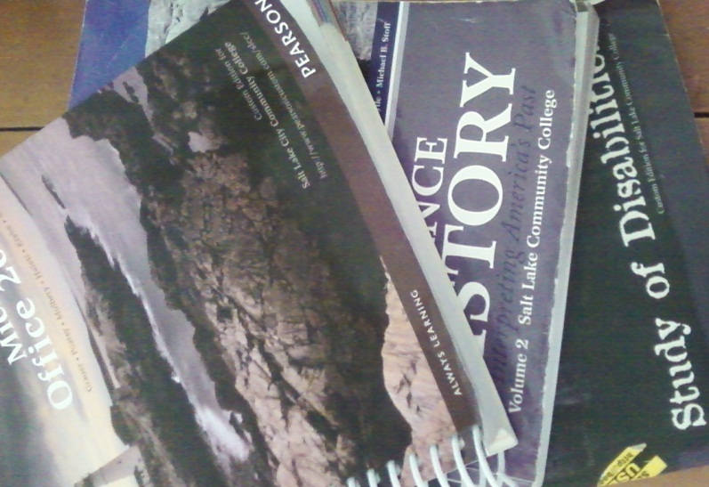
Our Proposal
  Replace SLCC custom editions of textbooks with a their standard counterpart
  Offer textbooks at a reduced price

Slide 5
Textbook Frustration
Expensive
Required text custom edition for SLCC
No used books available
Non-returnable
Not enough books available

Slide 6
  Over 30% of students in a resent survey said they were unable to acquire one or more of their textbooks before the semester
  15% of students said that there were no books available for a week or more after the start of the semester

Slide 7
SLCC Custom Editions vs
Standard Editions
Subject | Standard/Generic textbooks used per subject | SLCC Special Additions used per subject | Non-returnable standard textbooks | Non-returnable SLCC special addition textbooks | Percentage of non-returnable books | Average cost of standard texbook | Average cost of SLCC Special Addition
Trigonometry | 10 | 3 | 0 | 2 | 15.38% | $150.00 | $165.00
Biology | 8 | 6 | 0 | 6 | 42.86% | $180.00 | $175.00
Computer Science | 5 | 15 | 2 | 15 | 85.00% | $145.00 | $153.00
English | 6 | 9 | 0 | 7 | 46.67% | $120.00 | $138.00
Humanities | 8 | 10 | 0 | 6 | 33.33% | $120.00 | $126.00
Drawing | 3 | 16 | 1 | 10 | 57.89% | $80.00 | $73.00
Ethics | 6 | 7 | 0 | 5 | 38.46% | $75.00 | $76.00
Art History | 7 | 3 | 2 | 1 | 30.00% | $105.00 | $113.00
Buisiness | 8 | 5 | 2 | 3 | 38.46% | $145.00 | $162.00
Philosophy | 9 | 4 | 0 | 2 | 15.38% | $90.00 | $111.00

Slide 8
Cost of SLCC Custom Editions vs Standard Editions
Subject | Average price pre book at SLCC | Average Price book book at Amazon.com | Average recived on buy back at SLCC | Average received from selling back to Amazon.com | Per-book savings | Difference in sell back price | Total Savings if Purchased at Amazon
Trigonometry | $150.00 | $120.00 | $90.00 | $100.00 | $30.00 | $10.00 | $40.00
Biology | $180.00 | $145.00 | $45.00 | $130.00 | $35.00 | $85.00 | $120.00
Computer Science | $145.00 | $100.00 | $0.00 | $95.00 | $45.00 | $95.00 | $140.00
English | $120.00 | $95.00 | $60.00 | $75.00 | $25.00 | $15.00 | $40.00
Humanities | $120.00 | $100.00 | $0.00 | $80.00 | $20.00 | $80.00 | $100.00
Drawing | $80.00 | $65.00 | $35.00 | $40.00 | $15.00 | $5.00 | $20.00
Ethics | $75.00 | $55.00 | $30.00 | $40.00 | $20.00 | $10.00 | $30.00
Art History | $105.00 | $95.00 | $55.00 | $75.00 | $10.00 | $20.00 | $30.00
Buisiness | $145.00 | $120.00 | $75.00 | $100.00 | $25.00 | $25.00 | $50.00
Philosophy | $90.00 | $70.00 | $45.00 | $55.00 | $20.00 | $10.00 | $30.00

Slide 10
Student Benefits
More buying options
College bookstore
PJ’s bookstore
Amazon, eBay etcetera
Able to obtain needed textbooks in a timely matter
More money in pockets
Less expensive textbooks
More sell back options

Slide 11
Conclusion
Student would be able to sell their used books back to bookstore, on Amazon or to another student
Students would be able to finding the required text when they need it
Reduce textbook frustrations
Students will save a significant amount of money

